Slide 1


Communicating Benefits Effectively
(with the Employee's of Senior Services)
Notes:
The main goal of this presentation is to raise awareness about benefits that the employees have. Other factors are important too, but not as important as the ease of understanding how beneftis should work for the employees of senior services.

Slide 2








What is the Cost of “Doing Business”?
Notes:
Outside of salary, one of the most important factors for employee's is their benefits. A lot has changed since the pandemic started and more and more people are working offsite. This actually will make it harder for the company to remain competitive with their benefits. I'll explain why this is later, but for now we need to make sure that our benefits suits the needs of our employees and is easy to understand more than ever.

Slide 3



What should be the Goal of dealing with Benefits?
Understandability of Benefits to the employee's
Cutting Unnecessary Costs
Efficiency (ties in with Understandability)
Notes:
Our first and foremost goal is to make understanding benefits easy. That was the main point of our survey. The next goal would be to cut unnecessary costs. By helping employees understand their options better we'll be able to cut unnecessary costs. The last goal, efficiency, ties in with being able to understand the benefits. If employees understand their benefits well then time can be saved and efficiency can be increased.

Slide 4
What Does our Employees Think About Benefits?
" I like the fact that there is a lower cost option"
"I can afford to deal with a lower premium for a higher deductible"
"the fact you have only Wake Forest Physicians, they are not the greatest, the other choice (in the plan) offers more people (but costs more)"
"With Wake Forest you have a limited opinion"
"I've been here a long time and I'm satisfied, for a non-profit I think it's stellar"
Notes:
There was a wide range of responses I got from employees about their plans. However, the main take away that I got from asking people is that the thing they want the most is choice. The more good choices they have with their plans, the more satisfied they'll be.

Slide 5
Questions Considered Worth Answering
Does Currently Understanding Employee Benefits affect the Employee’s Enthusiasm for Learning about them?
What Combination of Communications does our employees understand the best?
Should We Combine Onsite and Offsite Employee’s for Meetings?
Giving Up/Trading Benefits
Notes:
I considered what questions the stakeholders wanted to ask before sending out the survey. They gave me a lot to work with, but I still had to interact with them in order to figure out what they wanted specifically. They wanted a lot of qualitative data but not a lot of quantitative data and that is where I slightly disagreed with them. I didn't need less qualitative data, I just needed more quantitive data to work with.

Slide 6
Questions Considered Worth Answering
Ranking Out of Pocket Medical Costs
What to do about the employee’s exercise room?
Are Our Benefits Competitive in different Locations around N.C.?
Should we offer multiple Medical health plans?
Notes:
This is a continuation of the questions I wanted to answer using the data. Most of these are qualitative as well. I did not consider locations outside of North Carolina for our benefit's competitiveness. If the stakeholders want to see other locations besides those in North Carolina I will gladly comply.

Slide 7
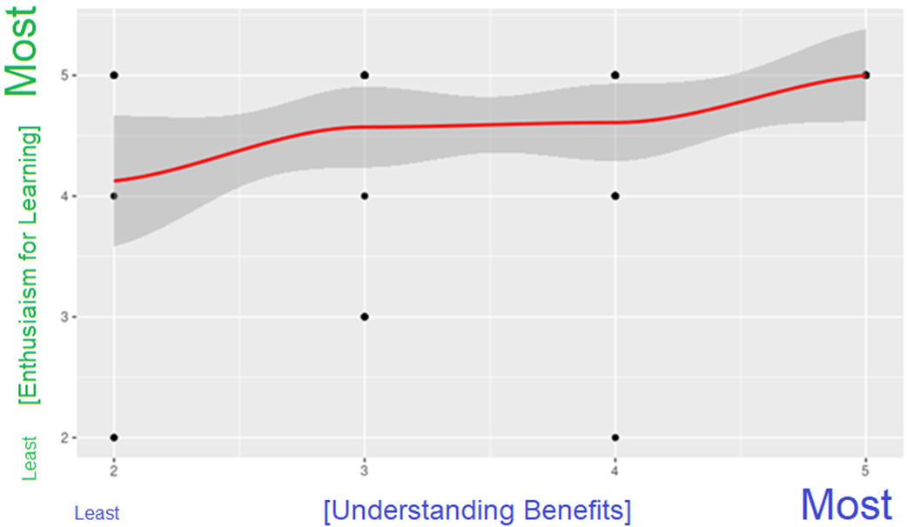
Understanding Benefits and Enthusiasm
Notes:
This is a correlation chart between those who understand their benefits currently and those who want to understand their benefits more. If you look at this chart you'll see that even people who don't currently understand their benefits want to understand their benefits quite lot. If you look at the best fit line (or the Red line) you'll notice it is pretty flat and not very vertical. The more vertical a line is the stronger the correlation between the two variables is. This line is very flat so it shows that there is a weak correlation between how much an employee understands and how much they want to understand. The good news here is that almost everyone wants to understand their benefits in depth.

Slide 8
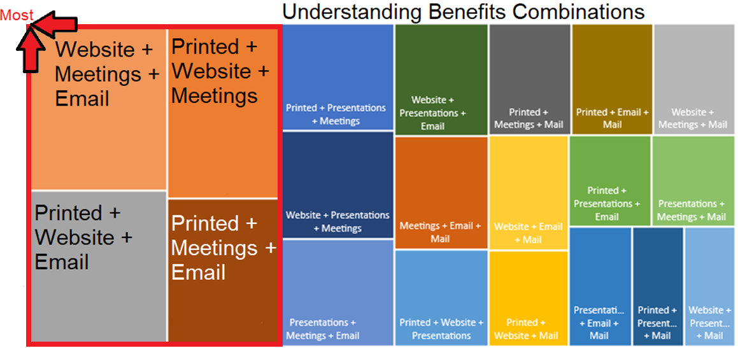
Best Form of Communications
Notes:
When you look at this chart, the closer you go towards the top and left of this chart the more people selected this combination of options for being the forms of communication that they want. The larger the size of the area of the option on the chart is another indicator of how many people selected the option as well. We don't need to look at every single option and this helps us narrow down the scope of the project by giving us four options to investigate.

Slide 9
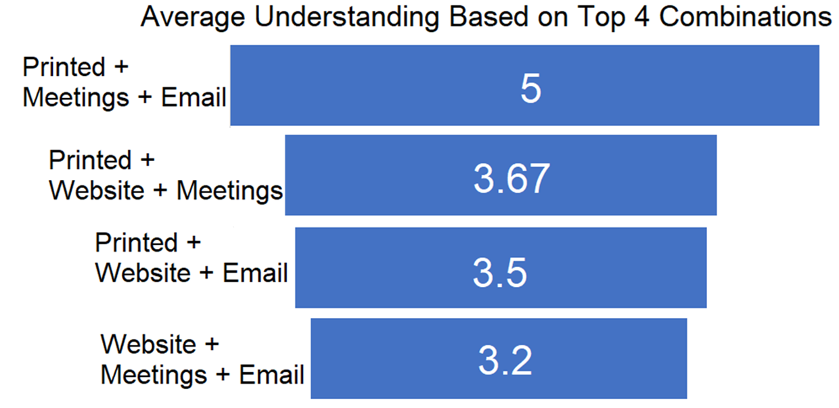
What Would Be the Best Combination of Communications?
Notes:
Of the four most understood combinations from our previous chart, Printed + Meetings + Email is on average the most understood out of the four top options. What I would suggest is that we give our employee's a written copy of their benefits and have an area on the written copy for questions that they can write down. Once a week or two has gone by we should hold a meeting that employees can attend and ask their questions that they have on the written copy. After the meeting has finished, we should send out an email copy with updates added to it from the meeting. This way the employees have a written ledger and a digital ledger that is updated. It seems people would prefer to have a meeting (as opposed to the website), which is likely because of the interactivity of the meeting (vs. Having to send an email to tech support if they used just a website).

Slide 10

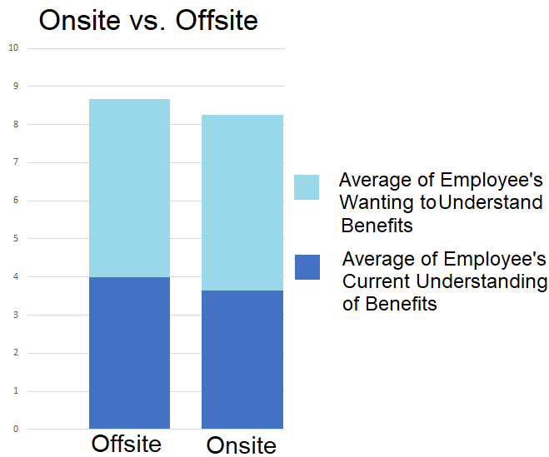

Does it Matter if Employee’s Remote in for Meetings?
Notes:
The Dark Blue is the Average of Employee's current Understanding of their Benefits. Offsite Employees actually understand benefits better than onsite employees. It is possible that the employees offsite have more options to pick from since a lot of them come from larger cities. The light blue is the average of employee's desire to understand their benefits. Both stacked together give us the total columns. As you can see from this chart they're both very close to one another.

Slide 11


How Should we Conduct Our Meetings?
We should host meetings on and off site at the same time.
Notes:
The difference between Onsite and Offsite Employee’s Total Enthusiasm and Ability Combined is roughly a 5% difference. Based on our confidence level we are 90% sure that the current understanding difference is between 0% and 13% (our margin of error is 8%). This is small enough of a difference to include offsite employees with onsite employees at the same meeting at the same time. There will not be a need to break up the meeting into two different meetings based on onsite and offsite employees. This will save time and be more efficient.

Slide 12
Trading Benefits and Ranking out of Pocket Medical Costs
User | What Benefits Should be Changed/Added to Our Plans?
1 | Fitness reimbursement plan: get rewarded for staying healthy. Treadmill desk/standup desk. Mental health days for living at home dept. Travel benefits, or 4 day work week.
2 | More Vacation days. Instead of years of service certificate, how about, every year we stay increased in vacation time. There is value in long term employees. Paid day off for our birthday etc. My husbands job , they keep giving them more and more vacation has a retention program. I am stuck at the same amount. His company keeps adding days.
3 | combine sick and vacation
4 | Is there such a thing as rewards/ incentives for being healthy and not utilizing medical and Rx benefits? :-) My PCP doctor (who I only see for sick visits) unbeknownst to me, dropped me as a patient because I had not been in in a couple years. Scheduler said I was too healthy. I had to get reestablished as a patient with this provider. I thankfully (knock on wood) and historically now for several years, I only see one medical provider (not my PCP) that can do all my wellness and preventative services in one visit annually. Also, the pre-loaded cards we received for certain purchases was VERY nice to have.
Notes:
I filtered the responses based on the options that were mentioned in question number 10 of our survey. Only 4 people requested changes to their benefits that matched the terms that were in question number 10. Only one person out of the 70 that took the survey wanted a reduction in benefits based on those terms found in question 10. I highlighted the specific part where they wanted the benefit in red so that it would be easier to skim the materials on the left. As of right now, vacation changes were mentioned the most.

Slide 13
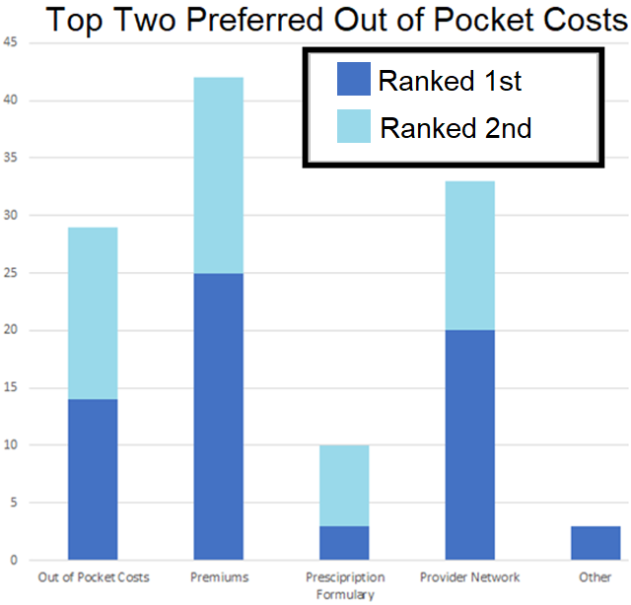
Ranking out of Pocket Medical Costs
Out of Pocket Medical Costs were Ranked from Most Important
(1st Ranked) to Least Important (5th Ranked)
Notes:
Out of pocket medical costs were ranked from 1 to 5. With 1 being 1st and 5 being 5th (or last). I plotted only the first two out of 4 or 5 because I felt that was the area we needed to focus on the most. This is about the halfway point for listing out all of the rankings, so it shows where people want to go with their Medical costs. The dark blue means they ranked the option number 1 out of 5 and the light blue means they ranked that option 2 out of 5. Employee’s wanted to change their premiums more than any other feature of Out-of-Pocket Medical costs.

Slide 14


What Benefits and Out of Pocket Medical Costs Should we Focus on?
Vacation and Wellness Prevention were the most popular options to change
Premiums were the most requested Out of Pocket Costs to Deal with
Notes:
Based on the chart in the previous slide employee's want vacation changed more so than any other option. They also requested wellness prevention. Premiums or cost of our premiums was considered the most important out of pocket medical costs that the employees cared about. This is likely because it must deal with the costs.

Slide 15
Dealing with the Exercise Room
In a typical year, how often have you used the exercise equipment at the Shorefair location?
1%
16%
3%
64%
13%
3%
Notes:
This chart uses stop light colors to give somewhat of a scale to the data. Green is the best, followed by light Green, Yellow, then Orange and last being Red (in that order). Only 4% of employees us the exercise room on a frequent or semi-frequent basis. It appears that the majority of employees never use the exercise room and we need to think about possibly repurposing the room.

Slide 16


What Could We Do About the Rarely Used Employee Exercise Room?
Possibly eliminate the Exercise room with offering a treadmill desk (or two) as an alternative for the staff to use
Offer Reduction in Premium Costs in our benefits plans to those who use the exercise room as part of a wellness prevention
Notes:
We have two major possibilities when it comes to the exercise room. Firstly, we could eliminate the exercise room and offer a treadmill desk for employees to use. One problem with this is though that we don't have an alternative for the other machines in the exercise room bedsides the treadmill. Another option which could help save the company and employees money would be to offer finacial incentives to exercising as part of a wellness prevention program. We could metaphorically speaking "Kill two birds with one stone" if we took this option.

Slide 17
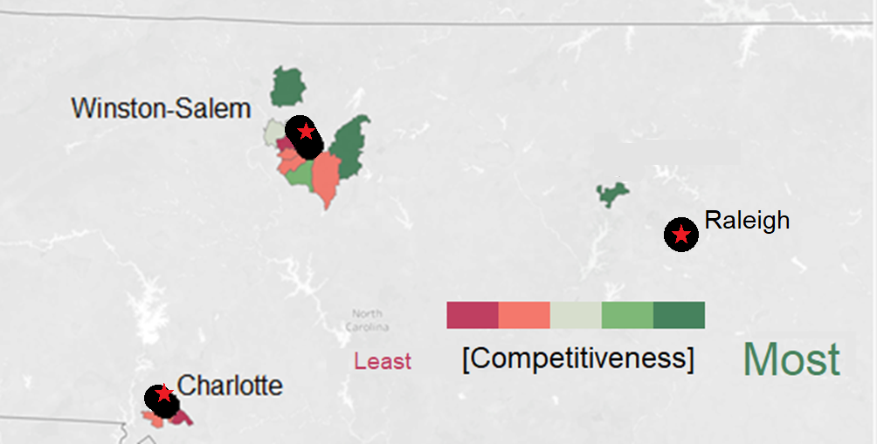
Ranking Our Benefit’s Plan Competitiveness (Compared to Other Companies’ Plans)
Notes:
In this chart the more red a zip code is the less competitive our benefit's plan is compared to other companies in that area. The star is the downtown location for the cities listed while the black area is the zone that is closest to downtown areas. According to this map it appears generally that zip codes that are closer to major downtown areas have more options to pick from when it comes to companies and health insurance plans. This isn't true 100% of the time (if you look atthe Winston-Salem there is one zip code that is green that borders a downtown area), but generally speaking, this is true.

Slide 18




Offering Multiple Plans
Should we offer two medical plans?
Notes:
Having multiple medical plans would be one of the most effective ways to make ourselves more competitive with downtown areas of major metropolitan areas like Raliegh, Charlotte and Winston-Salem. Multiple medical plans was requested by a large majority of the employees at Senior Services.

Slide 19


What Can We do to Remain Competitive Against Other Companies' Benefits Plan?
Consider either adding benefits or hiring from more rural areas.
Notes:
If we want to remain competitive in and near downtown areas of larger cities, we need to offer multiple medical plans and change the premiums. If the cost of increasing benefits is too expensive one way we could remain competitive is to seek out employees who live in less populated areas.

Slide 20
Conclusion
We need more quantitative data
I believe we should conduct a secondary survey based on what course of action stakeholders want to take
Some of these charts are available on Survey Alchemer but there is a lot of extra visualizations here that isn't available on Survey Alchemer
Notes:
I wish we had collected more quantitative data (I had to convert some of our data to quantitative numbers after being taken in qualitative terms, this qualitative data was in scale, so it was convertible). I also think we should take a secondary survey based on what course of action our stakeholders want to take (for example if we wanted a treadmill desk or if employees would rather have welfare prevention). Some of this data was accessible in the analytics of Survey Alchemer but I did a decent job diving into a more in-depth version of comparing different variables for charts that were not a part of Study Alchemer.

Slide 21
Main Takeaways from Questions
Print + Meetings + Email is the most effective combination of Communication
Hosting meetings as both on and off site at the same time is an efficient and effective way of meeting
Change Vacation and Wellness Prevention Options with our Plans
Change Premiums in Terms of Medical Out-of-Pocket Costs
Notes:
These are the main takeaways and call to action for what the data showed. If the stakeholders have any questions where I got the data from or what steps I took to get to these conclusions they can check out the appendix that will be posted online.

Slide 22
Main Takeaways from Questions
Possibly eliminating the Employee Exercise room and offer a treadmill desk (or two) that employees can share
Offering a wellness prevention plan to reduce premiums based on exercise
Seek out employees who live in Rural Areas surrounding large cities to save on costs
Most Importantly All levels of employees, regardless of their current understanding of our benefits care a lot about their benefits
Notes:
These are more takeaways from the questions that were presented during the project.

Slide 23

Appendix and Side Notes
The Sample Size was 70 out of a population that is close to 100.
(add Link to Kaggle or GitHub here)
Notes:
The population size of Senior Services is close to 100. I needed 52 people to respond to have a 90% confidence level at an 8% error rate. If anyone has any questions about the process or wants to understand the process I followed, then you should check out my Appendix

